Slide 1
The Impact of Kairos
Brian LeCrone
&
Dawnya Wineinger
Notes:
BRIAN, WHO ARE YOU?
Family
Kairos 13 years
London Council

Slide 4
A Prayer of Thanksgiving
Notes:
Jesus, come join us
in this Kairos journey
as we seek to follow Your will and Your command
To bring Your Love to the incarcerated and to their loved ones
Thank you Jesus for everyone here … for they took to heart Your command to visit the incarcerated.
… for the support of each volunteer’s family
… for the support of friends and churches
… for the Kairos staff
… pour hearts into program .. Fruitful & rewarding
… planning the conference
Teach us to love, not only those we serve through Kairos,
but everyone we meet as you love us
Teach us to give ourselves as you give yourself
So that Your beautiful and perfect kingdom
might be made present to all.

Slide 5
Devotional
Let’s Keep the Switch On
Rom 12:9 Your love must be without hypocrisy.
Notes:
A journey with God is a daily process of growth, transformation, and surrender. He uses the twists, turns, and trials of the spiritual road on which we travel to shape our character, teach us dependence, and reveal His presence.
With every Journey we take we must place our faith in Him to guide us. Because as we make our plans, we know that He ultimately determines our path. - Proverbs 16:9
My 1st Kairos was a powerful, enlightening experience.
When it was over I had never felt so willing to share Jesus’ love and wanted so much to continue serving Him.
For a short period of time we give love to incarcerated residents that changes their life.
We do it over and over again. For those short periods of time.
With those residents we are totally forgiving and free of self-centered motives.
We work to show our incarcerated brothers the very best side of our Christian faith.
But do we show that side to everyone else in our life?
There is much talk that suggests society treats our incarcerated poorly compared to our free citizens. One day, I began to wonder if I treat the citizens of the free world poorly compared to how I treat our incarcerated residents.
Do I try as hard to show my family and friends the very best side of my Christian faith … as I try when I’m in prison?
Rom 12:9 tells us our “love must be without hypocrisy”
I realized mine was not.

Slide 6
Devotional
Let’s Keep the Switch On
Rom 12:10 Be devoted to each other with mutual affection. Excel at showing respect for each other.
Tit 2:7 Always set an example for others by doing good actions. Teach with integrity and dignity.
1Th 5:11 So then, encourage one another and build each other up
Eph 4:29 “only what is good for building up people and meeting the need of the moment.”
Notes:
Rom 12:10 Be devoted to each other with mutual affection. Excel at showing respect for each other. (even your live-in mother-in-law)
(Tit 2:7) Always set an example for others by doing good actions. Teach with integrity and dignity. (not just for a few hours)
(1Th 5:11) So then, encourage one another and build each other up
In Ephesians (Eph 4:29) Paul says we should speak “only what is good for building up people and meeting the need of the moment.”

Slide 7
Devotional
Let’s Keep the Switch On
Gal 5:14 For the whole Law is summarized in a single statement: "You must love your neighbor as yourself.
Joh 13:34 I am giving you a new commandment to love one another. Just as I have loved you, you also should love one another.
Notes:
Paul says it beautifully in (Gal 5:14) For the whole Law is summarized in a single statement: "You must love your neighbor as yourself."
I know I’m not perfect and I never will be.
But that can’t be an excuse.
It must never become a crutch. Because I also know that I must strive to follow Jesus’ instructions.
Yes, the residents we serve almost never offend or annoy us. And we can walk away from the prison at the end of each day.
We must return to our daily lives with those who DO annoy us and offend us.
But are they doing that because we turn our switch off and do the same to them?
Is it not at least reasonable to expect ourselves to at least try to treat everyone with the same love and patience with which we treat our incarcerated residents?
That is what Jesus commands us to do.
John 13:34 - Just as I have loved you, you also should love one another.
It’s hard.
But I have to try harder.
I thank God and the Kairos program for showing me these things.

Slide 8



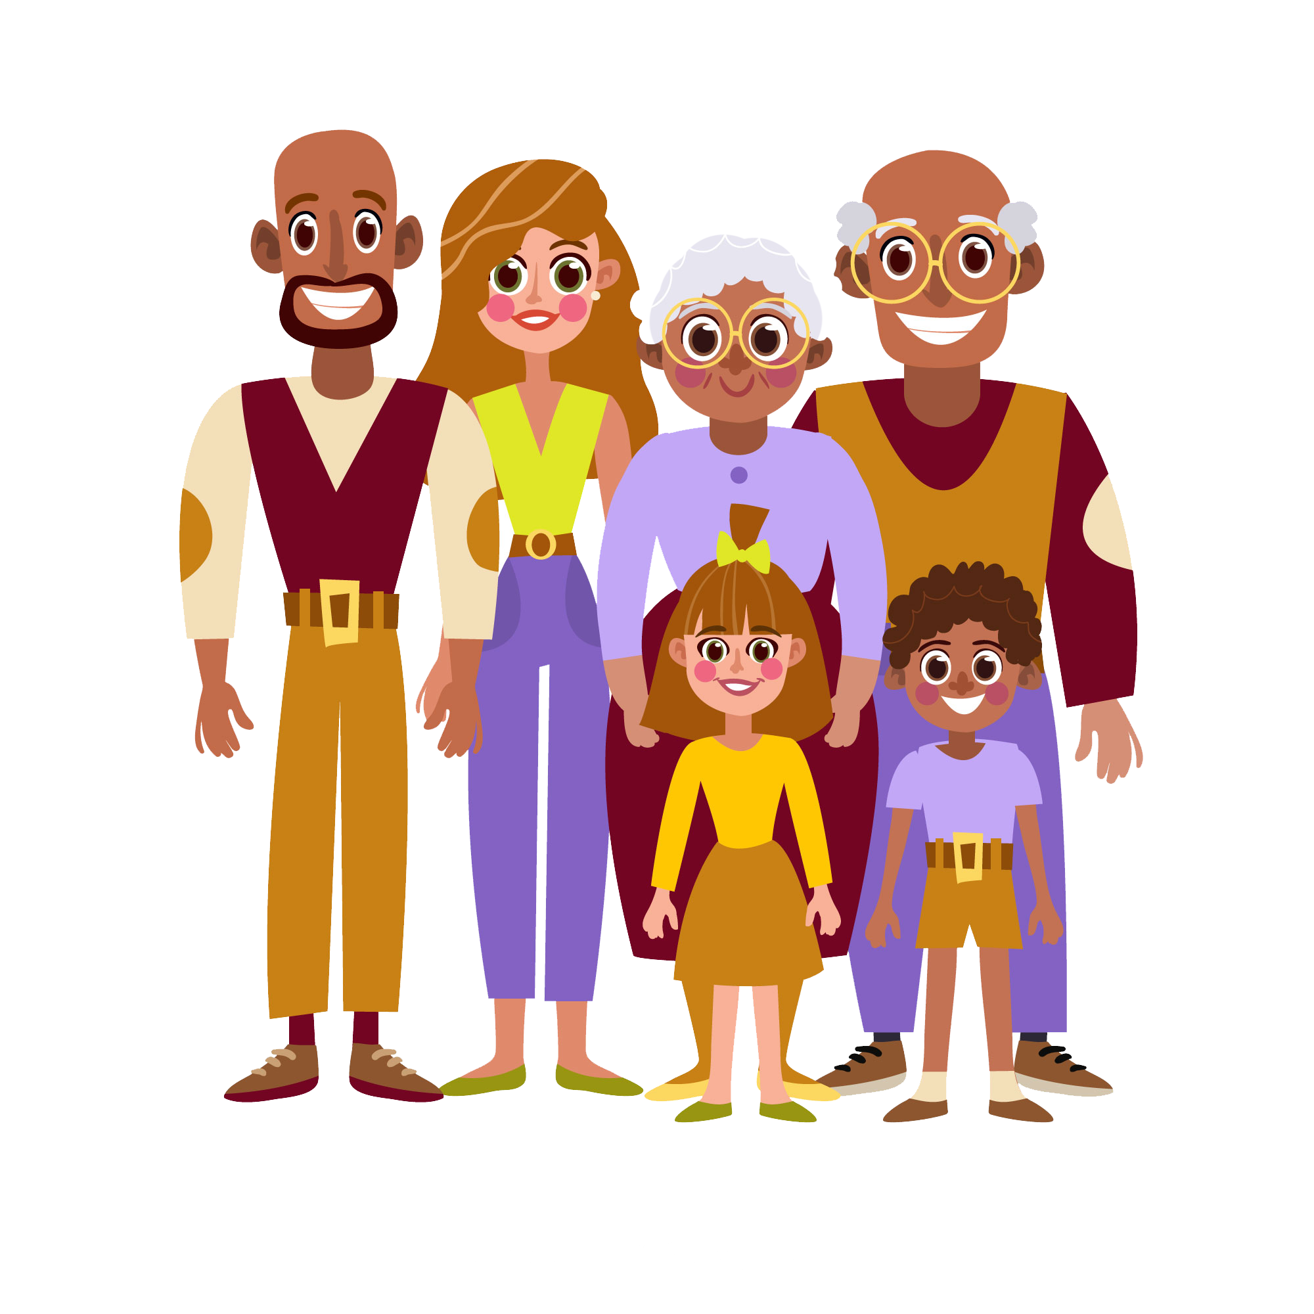



The Impact of Kairos
Notes:
Our journey with God is a daily process for sure.
A journey in Kairos is no exception. If you serve in Kairos for any length of time at all you will be a changed Christian.
Each Kairos journey has its own impact on a few or on thousands of people. Many people join us on our journey:
Volunteers and residents for sure …
but also resident families,
volunteer families,
friends and congregations …. All join us in one way or another on our journey through Kairos.
Some journeys may be only a few months.
For Many of our journeys span decades.
Many volunteers make an impact by serving on Kairos weekends. And many continue making an impact by serving in the continuing ministry of Kairos.
One thing is sure, all Kairos journeys effect lives in many different ways.
HOW DOES KAIROS IMPACT RESIDENTS

Slide 9
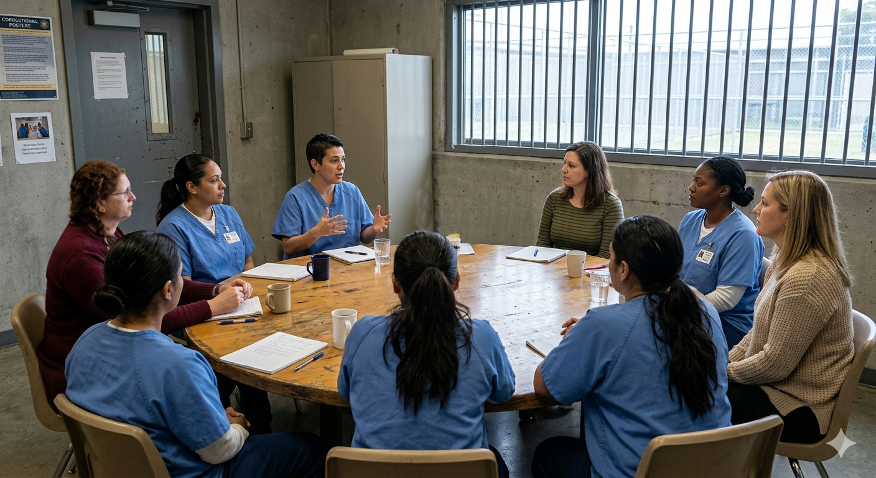
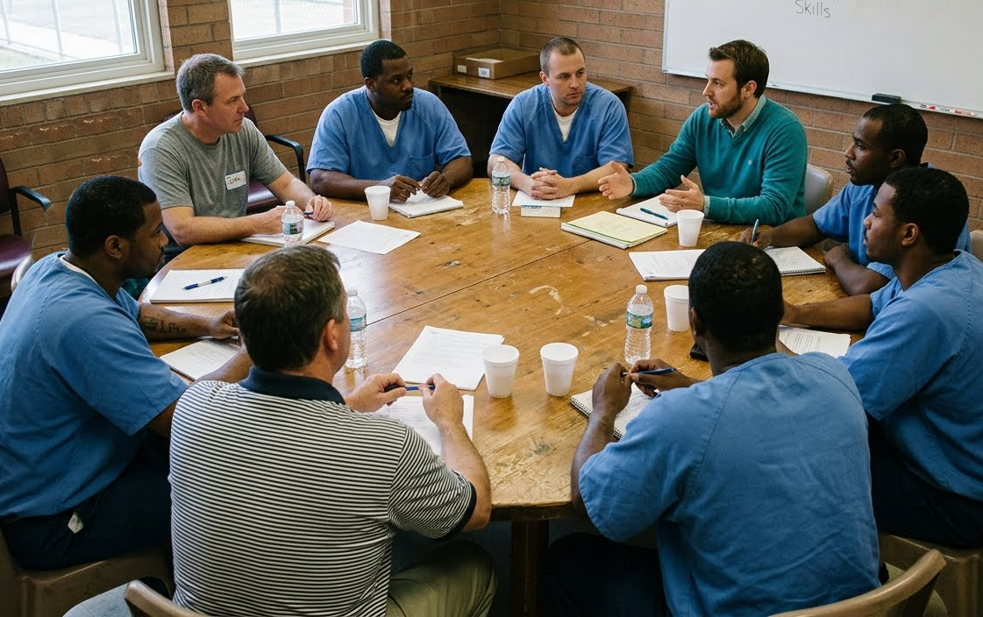
The Impact of Kairos on Residents
The Weekend
Notes:
How many have done 1 or 2 weekends?
Behind the Scenes vs At the Table
You never know the impact YOU are having
Kitchen team never meets but has great impact

Slide 10



The Impact of Kairos on Residents
The Continuing ministry
Instructional Reunion
Teaches Prayer & Share
P&S
Monthly Reunions
Encouragement
1 or 2 Day Retreat
Rekindles the passion
Notes:
Continuing Ministry has as big an Impact
Reunions
Shows that we continue to care
Adds credibility to our message
Retreats
Brings guys back to Prayer & Share
Prayer & Share
Becoming Loving productive citizens of their community
Small group counseled that guy with son in wreck
They are learning how to be accountable and to take care of each other

Slide 11
The Impact of Kairos on Residents
“really see the presence of God”
I learned a lot about Jesus that I never knew. I never knew such love existed. I am in awe.
“shown me that I am not alone”
“before I came to Kairos so I was so full of hate”
Notes:
Resident Comments
From our last weekend:
This has “shown me that I am not alone.
Before I came to Kairos I was so full of hate.
“really see the presence of God”
I learned a lot about Jesus that I never knew. I never knew such love existed. I am in awe.

Slide 12
The Impact of Kairos on Residents
I came to Kairos seeking Hope. I was lost, damaged, confused and abandoned. Today I’m filled with optimism and hope. I had a change of heart and now I have the tools to get closer to God.
Notes:
I came to Kairos seeking Hope. I was lost, damaged, confused and abandoned. Today I’m filled with optimism and hope. I had a change of heart and I have the tools to get closer to God.
Immediate Change or Years Later, out of nowhere:
KJ Letter; the guy hated me before the weekend
Guy from my weekend years later

Slide 13
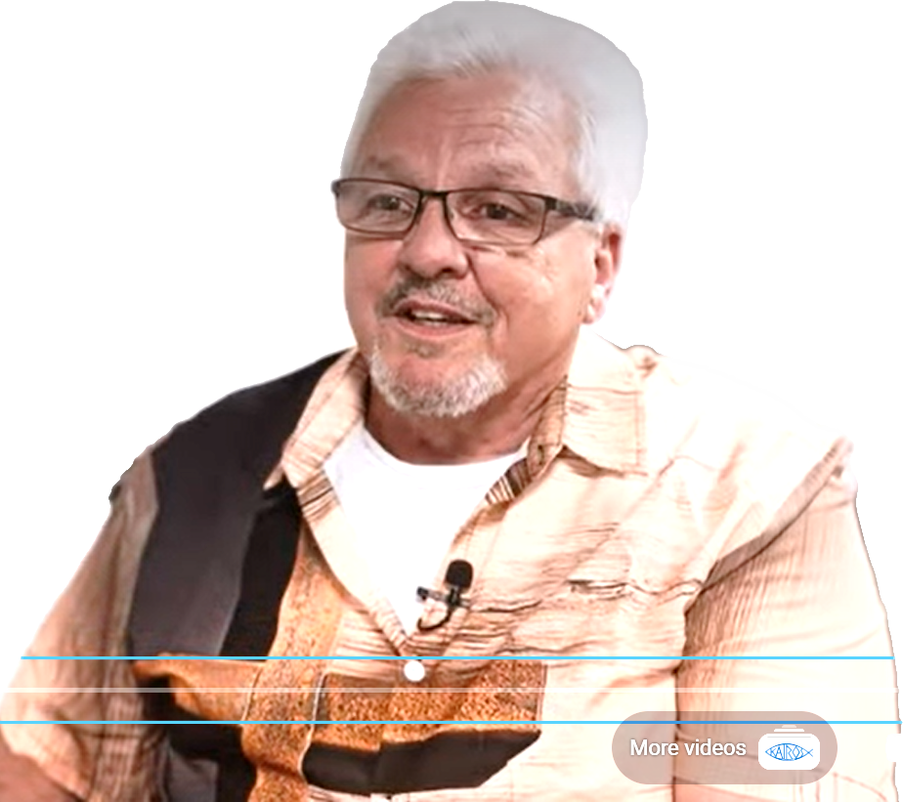
The Impact of Kairos on Ourselves
“Getting More than You Give”
Changes Our World Perspective
Character/Faith Building
Friendship Building
  Sacrifice
  Residents see it
Notes:
IMPACT ON OURSELVES
Getting more than …
Changes Our World Perspective
Not Animals
Just like me
Character/Faith Building
Learning forgiveness changed me forever
Better Father, Grandfather, Son, Husband
Teaches you skills
Weekend Jobs
Council Jobs
Manage, Chapel Operations, Food Service, Logistics
Friendships
Bonding
Team Meetings
Weekend itself
We have to depend on each other and when the schedule blows up we all work together to fix it
I started Kairos with a bunch of strangers and have since made a bunch of life-long friends
Sacrifice
Creates a spiritual unity
Multiple Denominations –
Sacrifice own agenda to unite as one
Resident’s comments

Slide 14
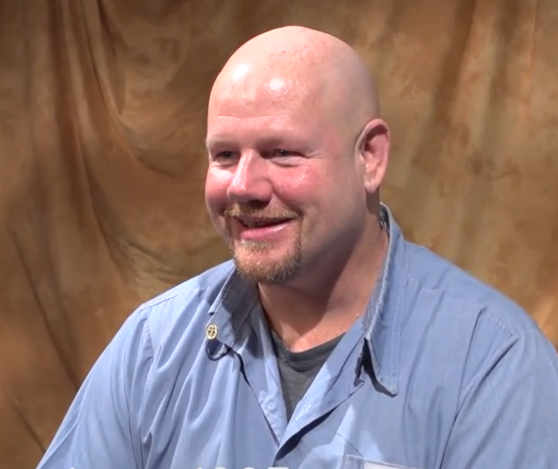
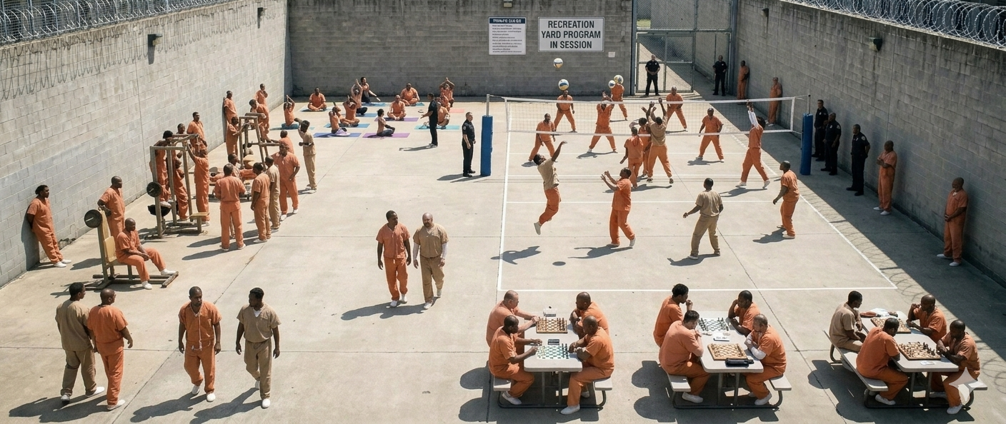
The Impact of Kairos on Others
Resident’s Families
Volunteer Families
Prison Community
Notes:
Resident’s Families
Cookies Save Lives (Stan Stever)
Impact of a Warden or Chaplain
Rebuilt Relationships
Volunteer Families
2. Volunteer’s Families
a) Dawn is supportive
Keep the switch on for family
b) Allows Teaching children by example
3. Volunteer’s fellow congregants
Community in Prison
1. Calm during weekend
2. IP-IP and IP-Staff violence down

Slide 15
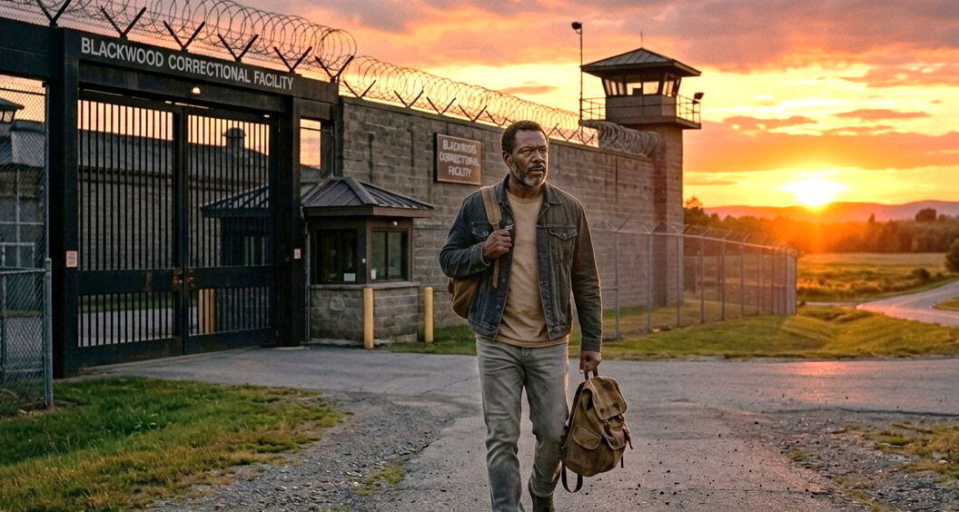
The Impact of Kairos on Community
Closing Guests
Reentry Work
Notes:
Closing Guests
Recruiting Tool
Way to get in for a little
Reentry Work
Cookies Save Lives – Stever Story
Aryan to Reentry Counselor
Resident to Kairos Volunteer
Impacts Staff - Chaplain Cahill to Volunteer
all sinners
all need Christ
all know that some staff don’t want us there

Slide 16
The Impact of Kairos on Community
Retired Chaplain Steve Cahill
"Of all the volunteer organizations I have brought into my chapel over 30 years, Kairo is the one that most consistently served the residents and the Lord. It is, in my opinion, the best organized and operated prison ministry I have experienced."

Slide 17
The Impact of Kairos on Community
Closing Guests
Reentry Work
Church Congregation
Notes:
Church
1. Demonstrate fulfilling Jesus’ command
to Congregation and friends:
a) Coloring placemats
(1) They keep them forever
b) Prayer chains
c) Cookies
d) Prayer Sign up
e) Financial
How does this shape the world view of our children, friends and congregation

Slide 18

The Impact of Kairos on Community
How Deep Into the Community Can Kairos Go?
Notes:
Kairos impacts differently each person it touches
Some short; some long;
Some a little; some a lot
It impacted me a lot:
Taught me forgiveness
Never heard that at Church
The need for Kairos’ impact goes much deeper into the community than the indirect impact that Kairos Inside can provide.
What about the incarcerated’s family on the outside?
Can God do for them what He is doing for their incarcerated loved ones through Kairos?
Dawnya is going to show you just how Kairos volunteers are impacting the incarcerated’s loved ones in communities around the world.

Slide 19

In the beginning…..
1989-The idea of Kairos Outside came from the Chaplain at San Quentin State Correctional Facility in California.
1990-Kairos Outside became a reality when Jo Chapman led the first Kairos Outside weekend in Northern California
Notes:
The idea of Kairos Outside came from the Chaplain at San Quentin State Correctional Facility in California. It was 1989, and he felt the prisoners who became involved in the Kairos program in the first Kairos Inside Weekend were now open to family unity. This “idea” became reality in Northern California in 1990---and I attended my first Kairos Outside weekend as a Guest in 2012. Even though it was 22 years later, the weekend was amazing. There was someone to meet me at the camp in Tyler--although I was 45 minutes late, they took in my bags and to dinner. I then began what was to be a life-long journey that changed my life.
How could a weekend—three days—change someone’s life? We are going to look into the lifespan of a Kairos Outside volunteer and the behavior and psychological processes that occur within the “Kairos” group. This is referred to as Group Dynamics, and I will reference the Science Behind Kairos as well. Many of these principles can be directed toward Torch although their process is much different.

Slide 20
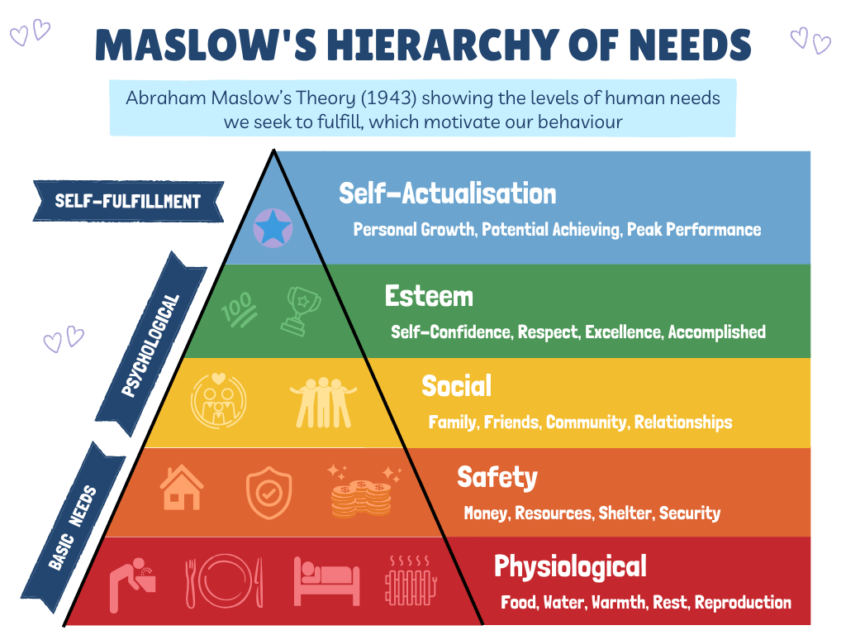
Belonging, community and hope bring change in the form of trauma healing, forgiveness, anger management and restored family relationships.**
Team Formation, SWAP groups, Reunions, Leadership Track
Guests are put in a table “family” to facilitate a spirit of sharing, to promote an attitude of community and open doors to friendships.*
Team contacts provide 1:1 relationships and become a “safe person” on Friday night.
During team formation we find out Guest’s favorite snacks, drinks, needs and provide them on the Weekend.
*2026 Kairos Outside Manual pg. 101
**https://mykairos.org/docs/ki/The%20Science%20Behind%20Kairos%20Impact%20upon%20Behavior.pdf
Notes:
Weekends are meant to be the starting point—they reach into a person’s life and fill them up in ways that only God knows they need. Truly, the weekend is designed to meet the needs as you see here in Maslow’s Hierarchy of Needs. On the Weekend Physiological, Safety, and Social needs are met. I understand the Weekend looks different in Torch, but the same concept is there.

Slide 21
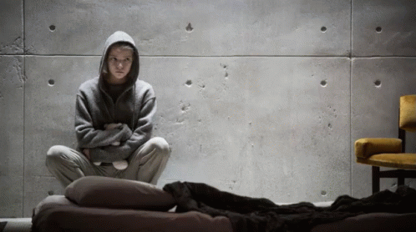
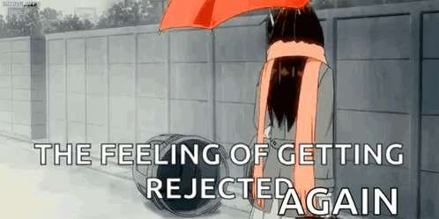
The Weekend
Group Dynamics: Why am I here? Why was I chosen? Do I want to be here? How can I add value to the team?
The weekend can have tremendous impact on the guest in helping her see and feel the love of God, so she can break free of her isolation.
Kairos Outside 2026 Manual
Notes:
The purpose of the Weekend is to give the Guest the reassurance that sharing and community are necessary and we then open the door to friendships. In Group dynamics we are in the Inclusion: “Why am I here” phase. Guests come to us from different walks of life, but they have one thing that is the same: they are impacted by incarceration. With this is a mind-set—do not trust what is going to happen because rejection is a real thing. And I probably deserve it.
The Weekend is designed to meet them where they are and offer a group that understands and supports them. During the Weekend there are 12 or 13 talks that are interrelated and build on each other to form one statement: God loves us all, completely and unconditionally, and all of us are accepted as we are, who we are, where we are. (2026 KO Manual pg. 148) We shower them with Agape love throughout, and on Sundays they are our Kairos sisters, and we celebrate them in Closing.

Slide 22
….. Continuing Ministry…
Group Dynamics
Reunions
By staying connected, the support systems that were established on the Weekend are strengthened, and the Kairos Outside community grows.
Will I use good judgment? Can I be an encouragement to others on our team? Do I demonstrate respect for others?
S.W.A.P. Groups
  Share
  Witness
  Account
  Pray
Notes:
Although the weekend is over the journey is not over. For Kairos Outside, team contacts are instructed to remain in contact for 6 months after the Weekend. We invite them to SWAP groups they were introduced into on the Weekend, we follow-up at the Reunion by asking them to fill out volunteer questionnaires and get them on Team—if that is best for the Team. In Group Dynamics we are in Power & Control: “Do I demonstrate respect for others?” The behavior that is shown during this time determines what is best for the Team….and for the individual as the grow in their journey.

Slide 23
…..we invite them on team, the Advisory Council…
Group Dynamics
Do team members demonstrate mutual respect? Do I Listen, Listen, Love, Love? Am I loving unconditionally?
6. Growth in personal relationships.
2026 Kairos Outside Manual/Kairos Outside Riverbanks, pg. 34
Notes:
After watching them work in a Core Team position and how they are able to handle an Inside position and Outside position, we then ask them onto the Leadership Track. All of this time we are building on what has been accomplished on the Weekend, and we are now in the Esteem portion of the Hierarchy of Needs. In Group dynamics we are in Affection: “Can I be an encouragement to others on our team? “Do I Listen, Listen, Love, Love?” “Am I loving unconditionally?” These questions can often be answered with a “NO!” and lead us to cry to Jesus and ask for His help and forgiveness. None of us are perfect…but we are imperfect together as we journey together.

Slide 24
Belonging, community and hope bring change in the form of trauma healing, forgiveness, anger management and restored family relationships.**
Team Formation, SWAP groups, Reunions, Leadership Track
Guests are put in a table “family” to facilitate a spirit of sharing, to promote an attitude of community and open doors to friendships.*
Team contacts provide 1:1 relationships and become a “safe person” on Friday night.
During team formation we find out Guest’s favorite snacks, drinks, needs and provide them on the Weekend.
*2026 Kairos Outside Manual pg. 101
**https://mykairos.org/docs/ki/The%20Science%20Behind%20Kairos%20Impact%20upon%20Behavior.pdf
Notes:
Weekends are meant to be the starting point—they reach into a person’s life and fill them up in ways that only God knows they need. Truly, the weekend is designed to meet the needs as you see here in Maslow’s Hierarchy of Needs. On the Weekend Physiological, Safety, and Social needs are met. I understand the Weekend looks different in Torch, but the same concept is there.

Slide 25
What determines if the journey is successful?
Have we stayed true to Kairos Prison Ministry
Mission Statement?
Riverbanks?
Manual?
Group Dynamics
Am I a Servant or Server? Is my serving less about me and more about Christ? How can I pay it forward?
Notes:
And the teacher in me wants to ask if the journey is successful…are we as a unit staying within the Riverbanks and following the Manual as best as we can? In whichever program you are in-Inside, Outside, or Torch--the steps in our journey have been walked before and the Kairos wisdom is in these documents. Are we fulfilling the Mission statement of the Kairos Prison Ministry?
The Mission of the Kairos Prison Ministry is to share the transforming love and forgiveness of Jesus Christ to impact the hearts and lives of incarcerated men, women, and youth, as well as their families, to become loving and productive citizens of their communities.

Slide 26
  Belonging, community and hope are a few of the self-actualization needs that are met through Kairos and bring change in the form of trauma healing, forgiveness, anger management and restored family relationships.
(The Science Behind Kairos)
  People who volunteer have lower mortality rates than those who do not, even when controlling for age, gender and physical health. https://www.mayoclinichealthsystem.org/hometown-health/speaking-of-health/3-health-benefits-of-volunteering
  The testimonies of how God has used Kairos to change our lives.
Impact of Kairos
Notes:
Has Kairos impacted the hearts and lives of the men, women, and youth we have served? Are we more loving and productive citizens of our communities? Have we been impacted?
I have been working with Kairos Outside of East Texas since I was a guest. I have seen this played out in so many ways. When we had a Kairos sisters’ husband pass away and our community has come to the Memorial service…I looked up through my tears and saw pew after pew of red KO East TX shirts.
I have gone to visit others in a surprise long hospital stay, and have been told how a Kairos volunteer-who lived 45 minutes away-had spent nights in the hospital with them and they have then taken their child to school the next day.
Sharing our life with others…this is the impact of Kairos.
I have asked for testimonies from others in my unit, and several spoke to my heart:
I would rate this experience a 10 out of 10 without hesitation. Kairos Outside of East Texas gave me healing, hope, friendship, and a sisterhood that I will forever cherish.
What makes Kairos so special is the way it creates a safe space for people to experience hope, healing, forgiveness, and genuine connection.
Through a Kairos Outside team meeting I was able to ask my KO brothers to help me understand what happens at a parole board hearing. I chose to attend and was able to find closure to an event that had negatively impacted my family, and I saw God turn sorrow into dancing! This was a blessing from God!
In my personal life, the answer is yes and continues to be yes. The journey is not over, we are constantly moving and growing spiritually. What about your life…would you be willing to share your testimony?
You can just email me your testimony, or I have a Google form I can share with you if you leave me your email address. These will be used by the Kairos Prison Ministry as they move forward to make an impact.

